Slide 1
MHB Protection Strategy
Develop a long range protection strategy so that leadership can have a measurable, outcome based strategy when implementing land protection programs. (easements, fee-title acquisitions, and SFIA forest incentive program).

Slide 2
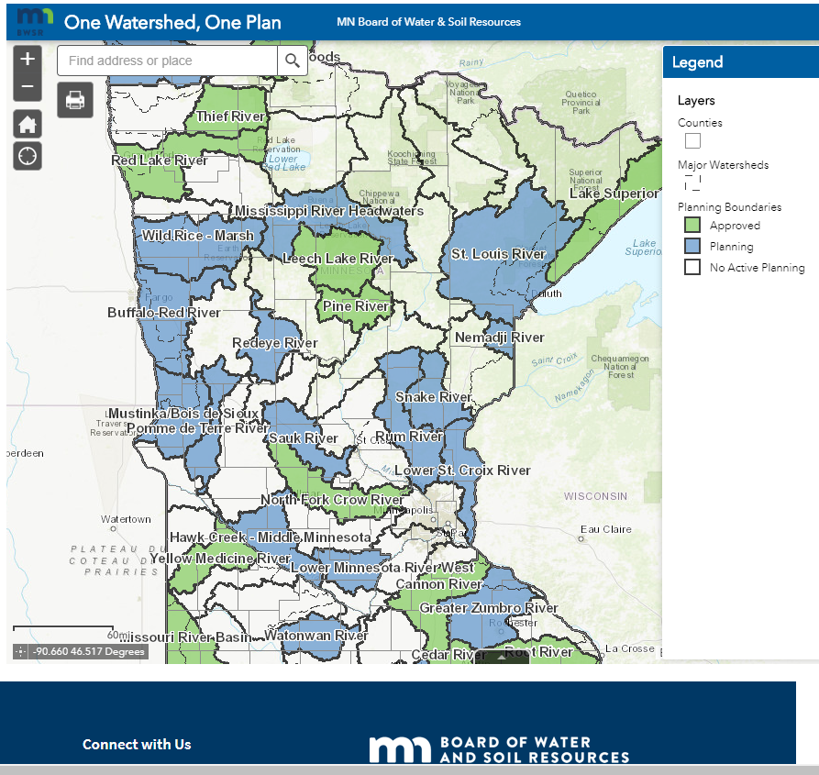
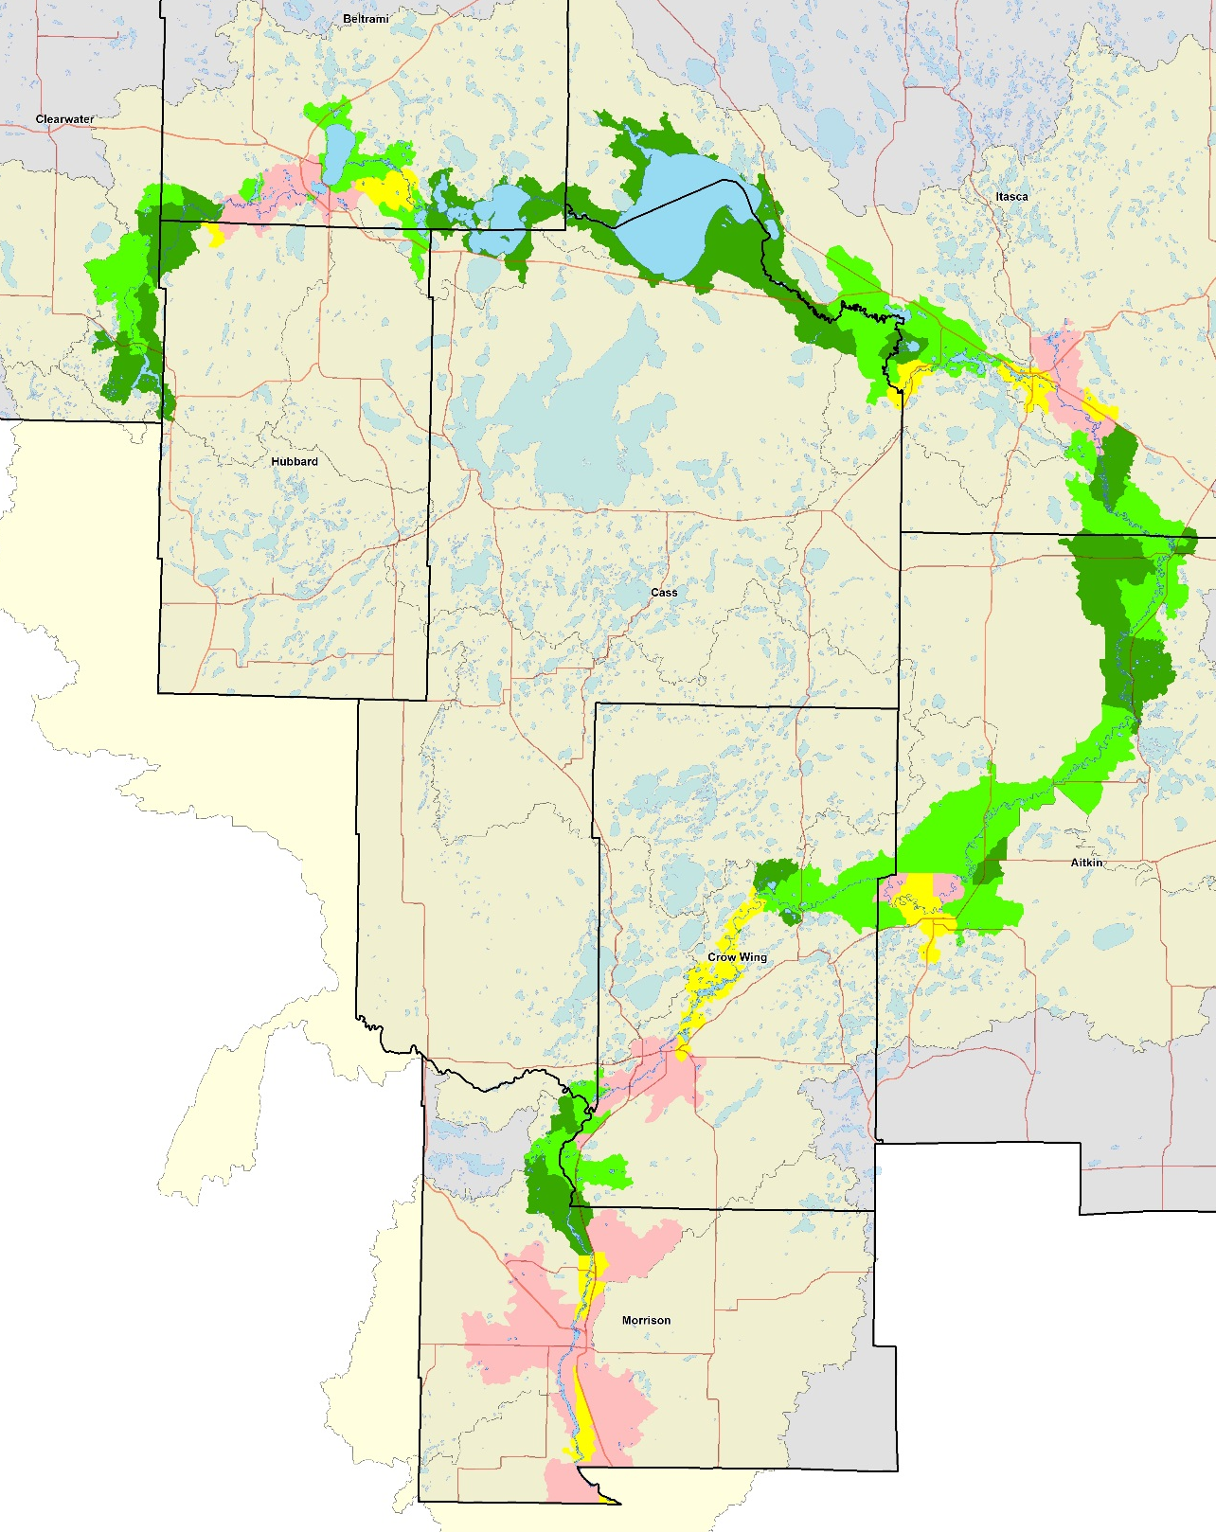
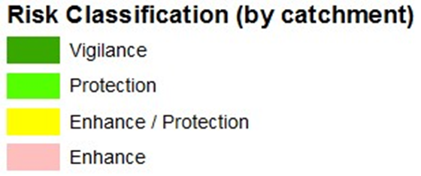
Context
38
38
Protection Goal = 75%

Slide 3

Can we still protect the Upper Mississippi from a water quality perspective?

Slide 4
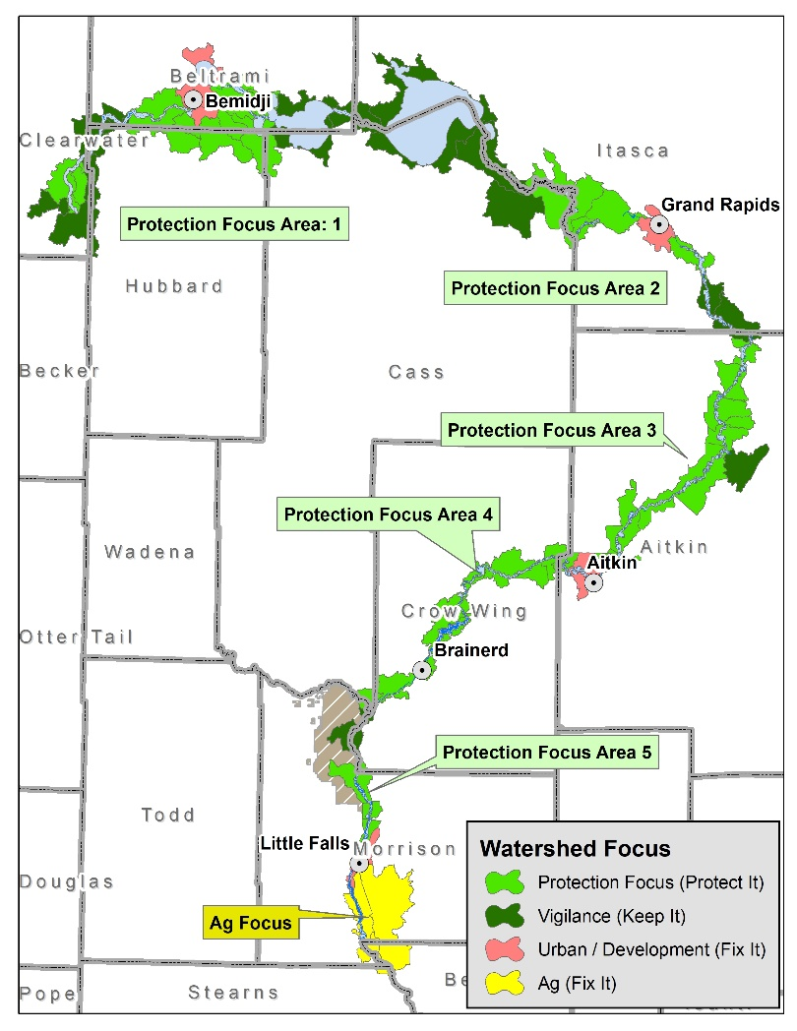
Breaking It Down to Smaller Pieces and Focus Areas
Protection priority Focused: 759,400 acres
Model does not apply to urban and agricultural areas (Fix it)
Vigilance Areas- already protected. (Chippewa National Forest)
Sentinel Landscape- Areas where successful implementation is already occurring.
Protection Focus- 78,400 acres.

Slide 5
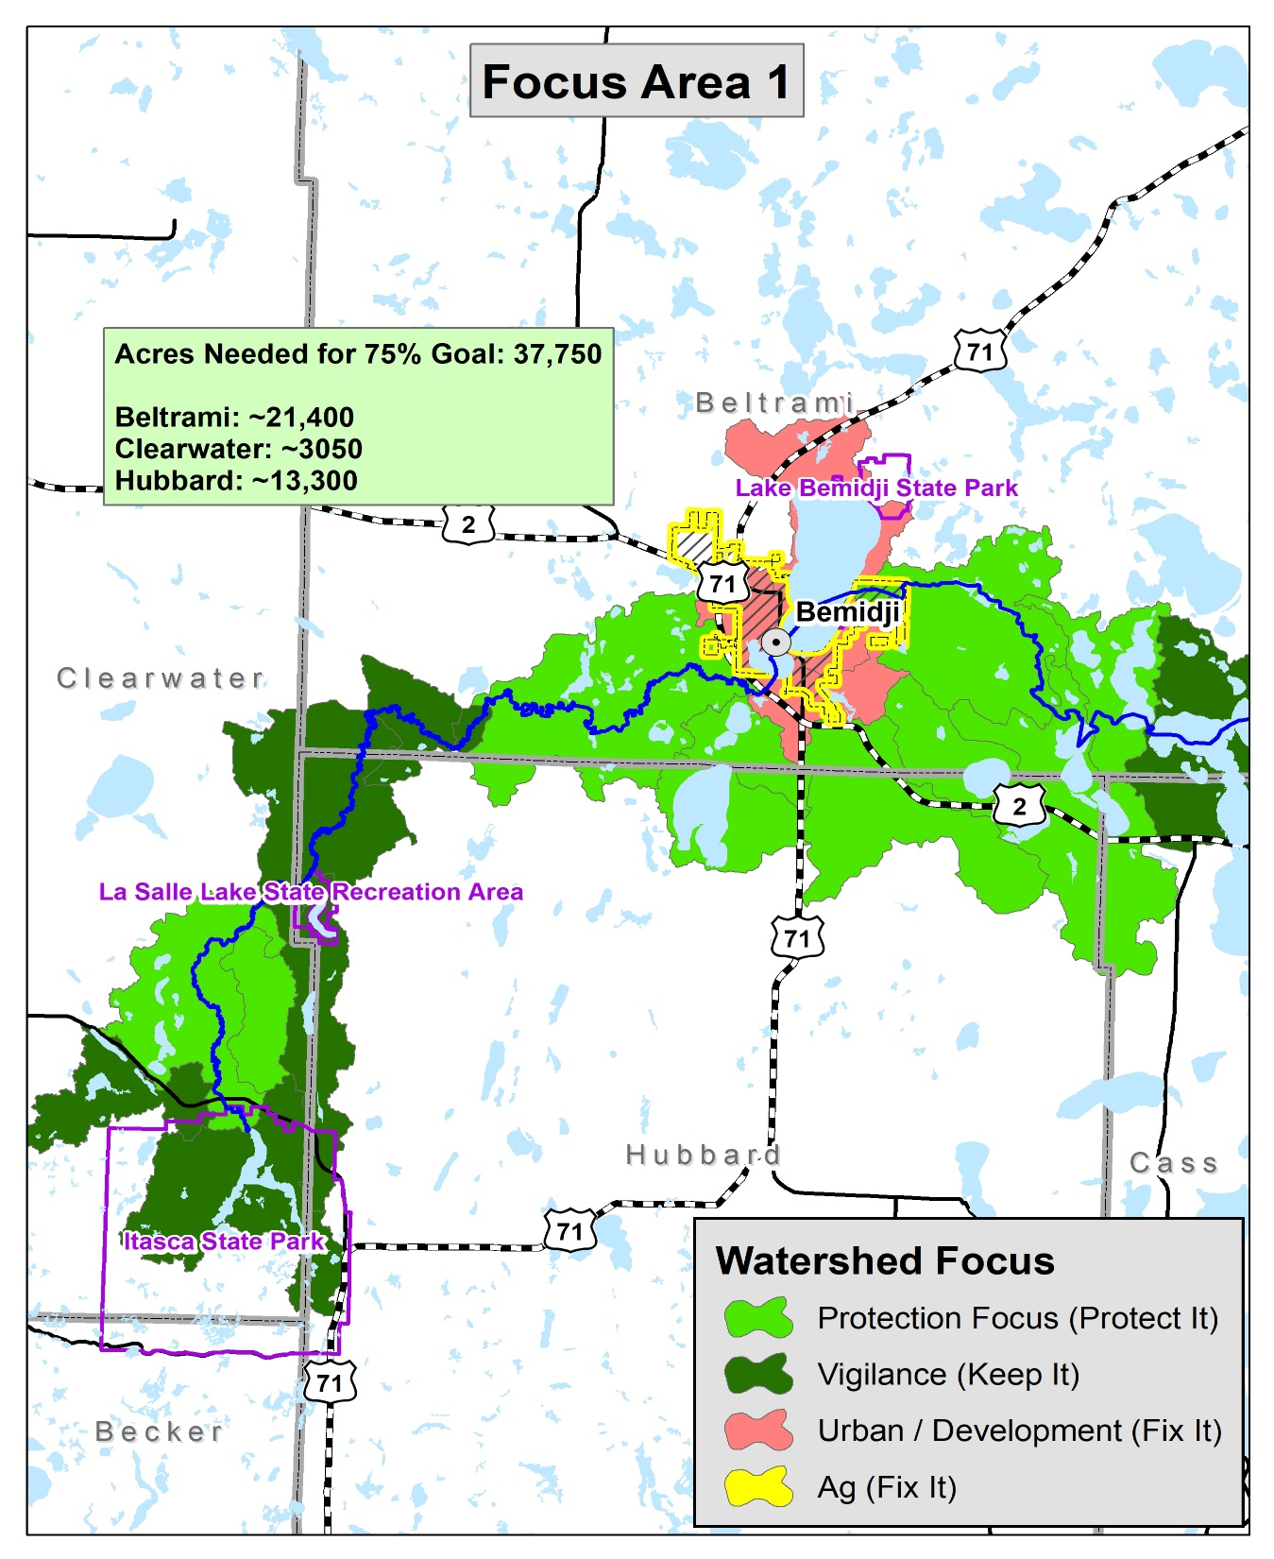

Slide 6
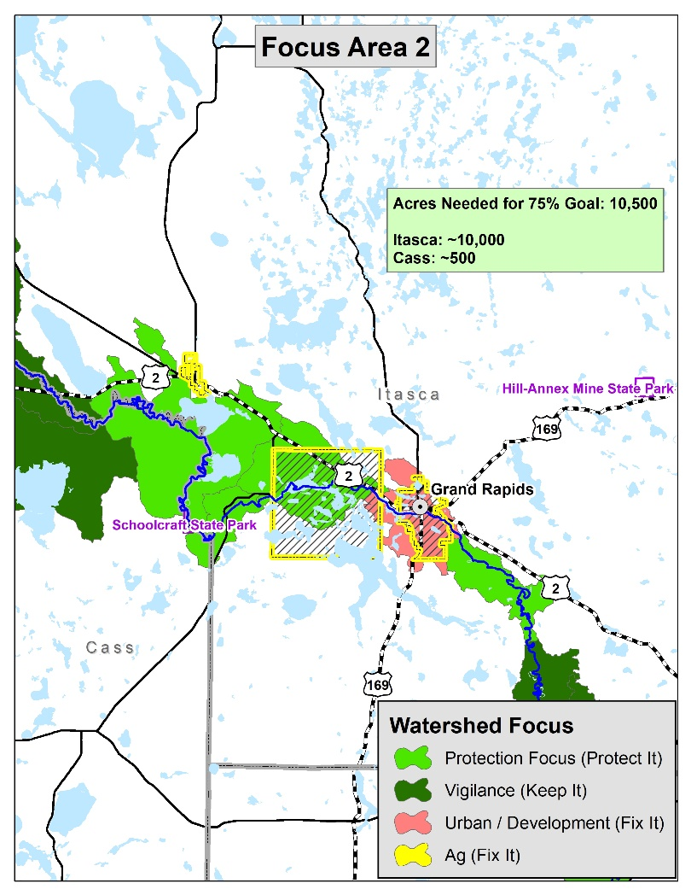

Slide 7
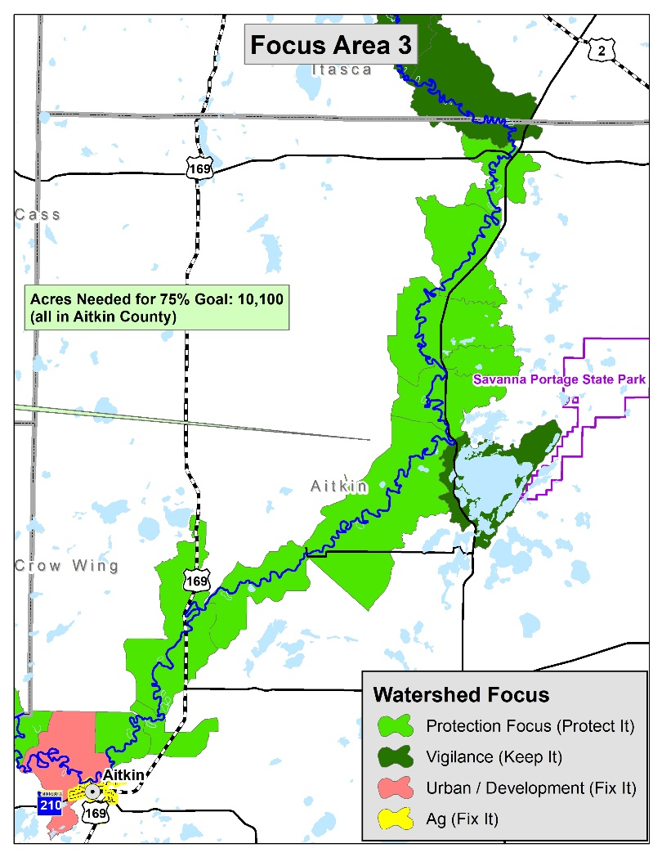

Slide 8
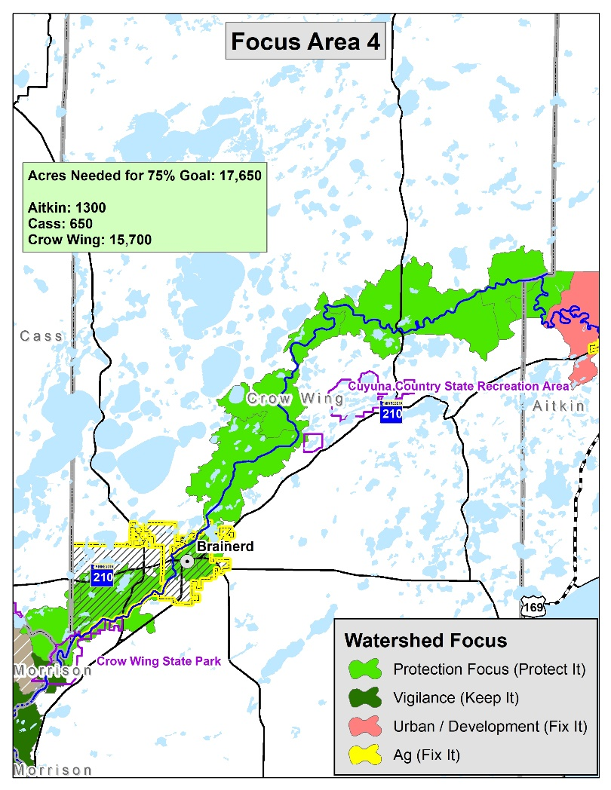

Slide 9
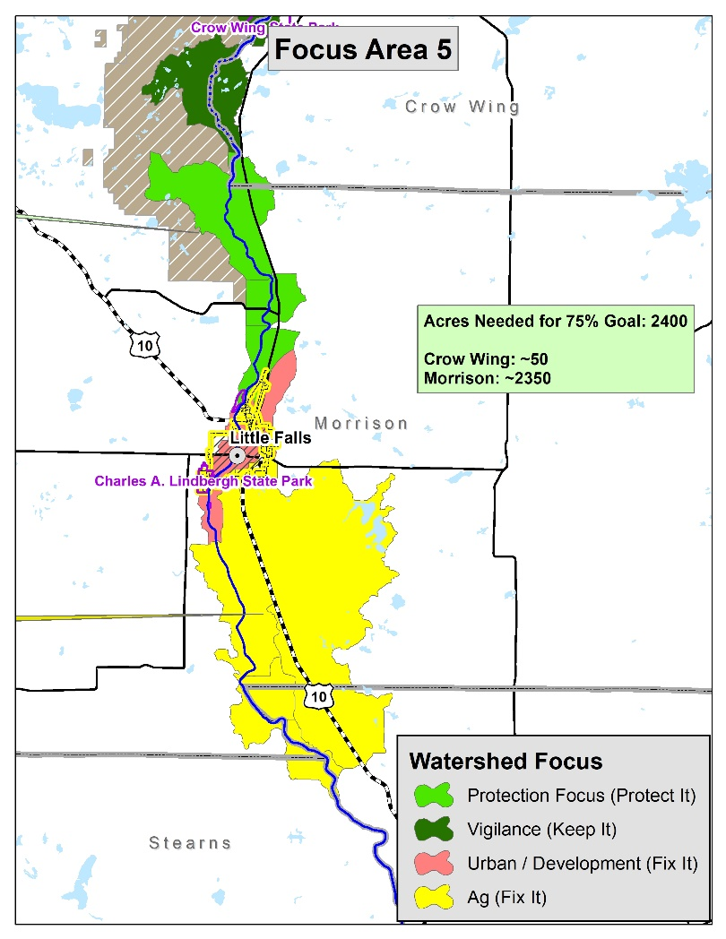

Slide 10
Final Thoughts
1W1P uses this strategy.
Camp Ripley Sentinel Landscape uses this strategy.
So why do this?
  This is an outcome based strategy to use as a measurement to determine success.
  Provides MHB board with a sense of accomplishment and is not mentally overwhelming.
  When you create a context and vision, people respond. AND Everyone sprints when they see the finish line!

